Slide 1
Università degli Studi dell'Aquila Parallel processing of large graphs
Supervisor
Prof.Guido Proietti
Presenters
Mohammad Sohrabi & Daniele Alaggia
Master Students of Department of Information Engineering, Computer Science and Mathematics

Slide 2
Parallel processing of large graphs Written By Tomasz Kajdanowicz Przemyslaw Kazienko Wojciech Indyk Wroclaw University of Technology, Poland
PUBLISHED BY Elsevier JURNAL
Future Generation Computer Systems

Slide 3
Content
Introduction
Related Works
Parallel architectures for graph processing
Open source parallel programming models
Similarities between MapReduce and BSP
Selected graph algorithms implementing parallel processing
Experimental environment
Results of experiments
Discussion and Conclusion

Slide 4
Introduction

Slide 5
1. INTRODUCTION
Graphs provide a very flexible abstraction for describing relationships between discrete objects
In many environments graph structures are so big that they require specialized processing methods, especially parallel ones.
As graph problems grow larger in scale and more ambitious in their complexity, they easily outgrow the computation and memory capacities of single processors.
The rise of the MapReduce concept and Hadoop—its open source implementation— provided researchers with a powerful tool to process large data collections.
Hadoop has become a de facto standard in academia and a significant solution for parallel processing in industry.
The MapReduce model is, however, badly suited for iterative and graph algorithms.
The main difference in the processing of regular data structures (tables) and relational models (graphs) relies on different problem decomposition.
Both different parallel processing methods, i.e. MapReduce and BSP, along with the map-side join MapReduce modification, have been implemented in the Hadoop environment—all three were used in the experiments presented in this paper.

Slide 6
Related Works

Slide 7
2. RELATED WORKS
The dynamic development of distributed and cloud computing has led to stable solutions for massive data processing
There are several concepts for parallel processing in clusters. Two of them are widely used in offline batch analysis systems and merit special attention: MapReduce and the less popular Bulk Synchronous Parallel (BSP).

Slide 8
Parallel Architecture for Graph Processing

Slide 9
3. PARALLEL ARCHITECTURE FOR GRAPH PROCESSING
Due to the fact that commercially available computer appliances have varying capabilities there can be distinguished several processing architectures suitable for distinct hardware. Depending on the amount of available storage and memory for computation the data might be processed in a different manner, reducing or increasing the latency. There can be distinguished to two main parts :
1.Distributed Memory Architecture
2. Shared Memory Architecture

Slide 10
Distributed Memory Architecture
The most widespread class of parallel computing is distributed memory architecture. This architecture comprises a set of machines (a set of processors and storage/memory) connected by a high speed network. It is possible that the environment can be composed of quite common machines and this makes the architecture inexpensive.
The general idea behind the distributed memory architecture is to implement the message passing technique.
One of the best known message passing styles in the distributed computing is Bulk Synchronous style. In general the processors in this technique switch from working independently on local data to performing collective communication operations

Slide 11
Shared Memory Architecture
There are two possible realizations of shared-memory architecture in computing: hardware based or software based.
Both of these approaches are required to provide support for global memory accessible for all processors.
One of the common realizations of shared-memory architecture are symmetric processors which can utilize global memory universally.
solutions of highly unstructured problems, such as graph processing, may benefit from that characteristic and achieve a higher performance than environments based on a distributed memory architecture.
The shared-memory approach is not ideal and thread synchronization and scheduling reveal another performance challenge. For instance, if several threads are trying to access the same region of memory, the system must apply some protocol to ensure correct program execution. Obviously, some threads may be blocked for a period of time.
the architecture requires processors that are not custom and more expensive than the ones used in distributed memory architecture.

Slide 12
Open Source Parallel Programing Models

Slide 13
4. OPEN SOURCE PARALLEL PROHGRAMING MODELS
MapReduce
BSP-Bulk Synchronous Parallel

Slide 14
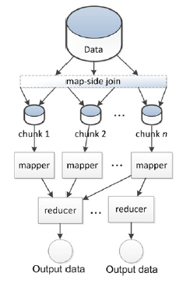
MapReduce
MapReduce is a parallel programming model especially dedicated for complex and distributed computations, which has been derived from the functional paradigm.
At each iteration independently, the whole data is split into chunks, which, in turn, are used as the input for mappers. Each chunk may be processed by only one mapper.
At each iteration independently, the whole data is split into chunks, which, in turn, are used as the input for mappers. Each chunk may be processed by only one mapper. Once the data is processed by mappers, they can emit ⟨key, value⟩ pairs to the reduce phase. Before the reduce phase the pairs are sorted and collected according to the key values, therefore each reducer gets the list of values related to a given key.
In the case of iterative graph processing algorithms, the graph structure and other static data, which do not change through computation, must be transferred over the network of computational nodes from mappers to reducers at each single iteration.
Data flow in the MapReduce programming model.

Slide 15
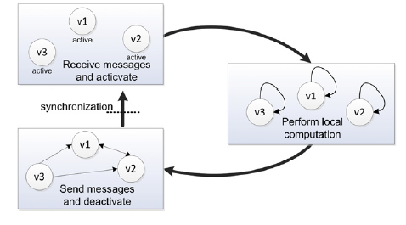
BSP-BULK SYNCHRONOUS PARALLEL
To address the problem of MapReduce inefficiency for iterative graph processing, Google has created another a distributed, faulttolerant system called Pregel, which is based on the Bulk Synchronous Parallel (BSP) processing model.
The computation process in BSP comprises of a series of supersteps (equivalent to MapReduce iterations).
Pregel and Pregel-inspired graph analytics systems are vertex-centric: a single agent computation has a graph representation in BSP. It consists of graph vertex identifiers, their current values or states, as well as lists of vertices’ outgoing edges.
Since the graph’s structure (especially edges and values assigned) does not need to be sent over the network at every superstep (iteration), BSP may be a very efficient graph computation model. Only specific messages necessary for the algorithm execution are exchanged between hosts.
Data flow in the Bulk Synchronous Parallel programming model.

Slide 16
Similarities between MapReduce and BSP

Slide 17
5. SIMILARITIES BETWEEN MAPREDUCE AND BSP
Partitioning of the Graph Vertex Set
Range Partitioning
Cluster Partitioning
2. Aggregation of Message
Combiners (Cumulative & Associative )
3. Graph Processing Using Map-Side Join Design Pattern in MapReduce
Schimmy
Map-Side Join

Slide 18
Selected graph algorithms implementing parallel processing

Slide 19
6. Selected graph algorithms implementing parallel processing
To evaluate the efficiency and other features of different parallel graph processing models, two separate problems were selected:
calculation of single source shortest paths (SSSP)
collective classification algorithm based on Relational Influence Propagation (RIP) used for collective classification of graph vertices
The analysis of the efficiency of SSSP and RIP solutions could also be common for other similar graph algorithms

Slide 20
Their three different implementations MapReduce, MapReduce with map-side join extension and Bulk Synchronous Parallel are depicted in the next figures

Slide 21
MapReduce model for processing of graph problems

Slide 22
MapReduce model with map-side join design patterns (MR2) in graph data processing

Slide 23
Bulk Synchronous Parallel model (BSP) in graph processing

Slide 24
Single source shortest path (SSSP)
For unweighed graphs, this problem can be interpreted as the computation of the minimal number of edges that form a path from an arbitrary chosen vertex to every other vertex in a graph.
Implementations of the algorithm have been studied and proposed both for MapReduce and for BSP

Slide 25
Main idea behind the algorithms (1)
At the beginning, all vertices are initiated with the maximum possible value and the source vertex with value 0.
In the first iteration, the source vertex sends an updated shortest path value equal to one to its immediate neighbours.
In the next iteration, these neighbours may propagate the path lengths incremented by 1 to their neighbours, and so on.
If received message contains a shortest path smaller than its currently stored value, the vertex becomes active and broadcasts the updated shortest path (increased by 1) to all its neighbours. Otherwise it does not send any message.

Slide 26
Main idea behind the algorithms (2)
In this way, at every iteration (MapReduce job/BSP superstep) a frontier of vertices with the newly discovered shortest paths is extended by one hop.

Slide 29
Collective classification of graph vertices based on Relational Influence Propagation (RIP)
The term collective classification refers to the specific classification task of a set of interlinked objects.
In collective classification, each vertex can be classified according to the generalized knowledge derived from correlations between the labels and attributes of vertices or correlations between the labels and observed attributes supplemented by labels of neighbouring vertices.

Slide 30
Collective classification can be accomplished by two distinct inference approaches:
within-network classification: tries to recover partially unknown labels in the network based on information of known ones
across-network classification: applies the recovered label distribution from one network to another
We are going to examine The within-network collective classification algorithm based on Relational Influence Propagation (RIP)

Slide 31
General idea
The general idea of this approach is based on the iterative propagation of the known labels assigned to some known vertices to the non-labelled vertices in the same network.

Slide 34
Experimental environment

Slide 35
7. EXPRIMENTAL ENVIROMNTAL
The main goal of experiments was to validate and compare the open source parallel programming models:
MapReduce (MR)
MapReduce with map-side join (MR2)
Bulk Synchronous Parallel (BSP)
These three approaches: MR, MR2 and BSP were evaluated in terms of computational complexity for distinct settings of a distributed environment
The analysis was performed for distinct real world datasets and for two graph analysis problems: SSSP and RIP

Slide 36
Environment setup
The experiments were carried out using a cluster environment provided by the Wroclaw Networking and Supercomputing Center.
The distributed system consisted of 85 identical machines with 4 CPUs, 16 GB RAM and 750 GB of storage each.
Computers were connected through 1 Gb/s Ethernet.
The experiments were deployed on Hadoop (version 0.20.205.0) and Apache Giraph (version 0.2).

Slide 37
Datasets
To compare the MapReduce and BSP approaches four separate datasets were used:
tele
tele_small
youtube
twitter

Slide 38
tele dataset
The tele dataset is a network of telecommunication clients built over three months history of phone calls from one of the leading European telecommunication company.
The raw dataset used to construct the network consisted of about 500 000 000 phone calls and more than 16 million unique users.
Extracted network was built using the activities of clients performing calls in the two most popular tariffs from 38 tariffs.

Slide 39
tele_small dataset
Tele_small was based on the next two most common tariffs.
In both datasets (tele and tele_small) users were marked with the empirical probability of the tariffs they used, namely, the sum of outcoming phone call durations in a particular tariff was divided by summarized duration of all outcoming calls

Slide 40
YouTube dataset
The YouTube dataset was crawled using the YouTubeAPI in 2008.
A subset of all attributes was used to create a weighted graph structure and labels: video_id, age, category, related_IDs.
Using related_IDs the connection strengths were calculated as a fraction of the number of related adjacent videos.

Slide 41
Twitter dataset
The Twitter dataset was the largest dataset utilized in the experiments. It contained a list of two users’ identifiers, implying a link from the first to the second user (the first user follows the second one).
As there were no available labels for a user class was assigned randomly to each of the network vertices using the uniform distribution.

Slide 42
Results of Experiments

Slide 43
8. RESULTS OF EXPRIMENTS
MR, MR2 and BSP approaches were examined against the type of graph processing problems using a fixed number of computational nodes (60 machines).
The Relational Influence Propagation (RIP) as well as Single Source Shortest Paths (SSSP) problems were executed in order to test the execution time.
The results for three parallel approaches separately for the RIP and SSSP problems are presented in the next figures.

Slide 44
Performance of Relational Influence Propagation problem on 60 machines (with the percentage drop of mean iteration time in comparison to MR).

Slide 45
Performance of Single Source Shortest Paths on 60 machines (with the percentage drop of mean iteration time in comparison to MR).

Slide 46
Scalability in relation to the graph size
The next research focused on the question, how the processing time of MR, MR2 and BSP solutions depends on the sizes of graphs for the fixed configuration (60 machines).
Again, the experiment was performed on three datasets with significantly different numbers of nodes (tele_small, tele and twitter).

Slide 47
Scalability with respect to the size of graph for the Relational Influence Propagation algorithm with a fixed number of machines (60).

Slide 48
Scalability with respect to the size of graph for the Single Source Shortest Path algorithm with a fixed number of machines (60).

Slide 49
Horizontal scalability in relation to the number of parallel machines
The influence of the computer cluster (cloud) size on efficiency (processing time) was also examined.
Three parallel models (MR, MR2 and BSP) were compared against each other for different numbers of machines, starting from 5 to 85.

Slide 50
Scalability with respect to the number of hosts (nodes) in the computer cluster for the: Relational Influence Propagation (RIP) algorithm applied to tele_small (a), tele (b), youtube (c), twitter (d) datasets Single Source Shortest Path (SSSP) algorithm executed on tele_small (e), tele (f), youtube (g), twitter (h) datasets.

Slide 51
Scalability in relation to the number of algorithm iterations
The total processing time for RIP and SSSP algorithms, considering just tele dataset, is shown in next figures.
We will see that in all approaches, regardless of the calculated problem, the processing time increases linearly with the number of iterations.

Slide 52
Total processing time with respect to the number of iterations in the Relational Influence Propagation algorithm run on 40 machines (tele dataset).

Slide 53
Total processing time with respect to the number of iterations in the Single Source Shortest Path algorithm executed on 40 machines (tele dataset).

Slide 54
Resource usage over time
The detailed charts with the consumption of the main resources include data about:
CPU usage of processing machines (cluster)
CPU usage for the master host
network traffic (communication between hosts)
memory occupation for processing hosts and separately for the master host

Slide 55
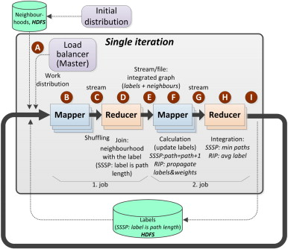
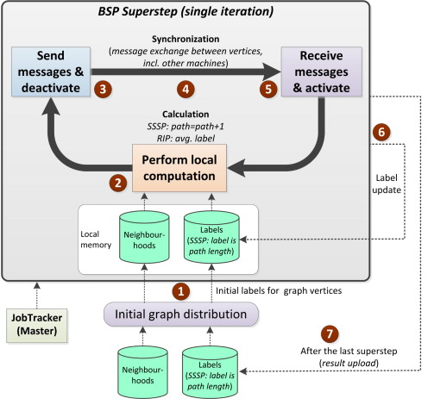
Resource usage for the Relational Influence Propagation (RIP) problem and tele dataset.

Slide 56
Resource usage for the SSSP problem and tele dataset.

Slide 57
Discussion and Conclusion

Slide 58
9. DISCUSSION AND CONCLUSION
The results presented revealed that the MapReduce approach (MR) is outperformed by Bulk Synchronous Parallel (BSP) as well as by application of the map-side join design pattern (MR2).
Simultaneously, it was discovered that the map-side join design pattern (MR2) may improve the original MapReduce performance up to two times.
The general concept of the BSP model facilitates in-memory computation for the entire graph. This is the main reason why the BSP implementation outperforms MapReduce for all considered graph-based problems.

Slide 59
However, in-memory processing requires that the whole graph structure and all intermediate data produced during processing (e.g. messages exchanged between vertices) must fit in the memory.
Hence, for very large networks, MapReduce remains the only alternative. The risk of not fitting in memory is higher for more communication intensive problems such as Relational Influence Propagation. The BSP model may be a very good solution for non-iterative graph algorithms.

Slide 60
The necessity of data exchange and access to distributed file systems (HDFS) grows with a higher number of parallel machines.
As a result, adding new machines does not need to decrease the average processing of a single algorithm iteration. For the datasets and graph problems analysed in the experiments, the reasonable upper limit of computational nodes is about 20–30

Slide 61
MapReduce can still remain the only mature enough alternative for parallel processing of graph algorithms on huge datasets. It results from the main BSP limitation: the very high memory requirements—all the data used for local processing in BSP must fit in the local memory.

Slide 62
Recently some implementations of the BSP processing model are also becoming more and more mature (Apache Giraph)
New framework for MapReduce in-memory computations has just been developed (Spark project at Berkeley University)
The comparison of both in-memory frameworks for BSP (Giraph) and MapReduce (Spark) could be a very interesting direction for future work.

Slide 63
Reference
http://www.sciencedirect.com/science/article/pii/S0167739X13001726

Slide 64
QUESTIONS?

Slide 65
Thank you for the attention

